Slide 1
Aspect-Based Sentiment
Analysis in Restaurant Reviews
CSCE 5218 - Deep Learning
Abhiram Reddy Pudi
Saketh Papareddy
Maddineni Naga Sampath
Karthik Choudhary Etukuri

Slide 2
Problem Statement
What is ABSA?
General Sentiment Analysis: Classifies overall text sentiment (e.g., Positive/Negative review).
Limitation: Misses fine-grained details.
Limitation: Misses fine-grained details.
Aspect-Based Sentiment Analysis (ABSA): A deeper dive.
The system needs to track individual topics or features that enter the assessment as well as connect related sentiment values to these aspects.
Example:
The delicious pizza received high praise yet the staff provided slow service.
Sub-tasks:
The extraction system detects "pizza" and "service" through Aspect Term Extraction (ATE).
Aspect Sentiment Classification (ASC): Assigning "positive", "negative".

Slide 3
Why is ABSA Important?
Through Business Intelligence the company can acquire specific customer opinions regarding individual elements of their products or services such as food quality and prices and staff performance and restaurant environment.
The system reveals precise areas for enhancement including solutions for slow service and pizza promotions based on customer feedback.
An examination of customer sentiment regarding individual product characteristics can be tracked both within and among competitors through time.
The analysis requires interpretation of text context along with negation detection and evaluation of different elements and sentiments which exist throughout complicated sentences.

Slide 4
Project Goal & Contribution
Goal: To implement and compare two deep learning pipeline approaches for end-to-end ABSA on restaurant reviews.
Approach 1 (Pipeline): Modern Transformer (RoBERTa) for both ATE and ASC.
Approach 2 (Baseline): Transformer (RoBERTa) for ATE + BiLSTM and ASC.
Contribution: Empirically quantify the performance difference between a state-of-the-art Transformer ASC and a strong LSTM baseline ASC within the same ATE framework on this dataset.

Slide 5
Dataset Description
Source
SemEval Restaurant Review Dataset (Restaurants_Train.xml).
Size:
Total Sentences: 3044
Training Split: 2435 sentences (80%)
Test Split: 609 sentences (20%)
Annotations:
Sentences marked with <sentence>.
Aspect terms marked with <aspectTerm>, including:
term: The aspect text (e.g., "staff").
from/to: Character offsets.
polarity: Sentiment label.

Slide 6
Sentiment Classes (4):
positive, negative, neutral, conflict.
Example Annotation (from ID 3121):
<sentence id="3121">
<text>But the staff was so horrible to us.</text>
<aspectTerms>
<aspectTerm term="staff" polarity="negative" from="8" to="13" />
</aspectTerms>
</sentence>

Slide 7
Proposed Model & Baseline - Overall Pipeline
Two-Stage Pipeline Approach:
ATE Model: Identifies aspect term spans in the sentence.
ASC Model: Classifies sentiment for each term found by ATE.
SHARED Component: Both approaches use the exact same trained ATE model.
Model: RoBERTa-base (roberta-base) fine-tuned for Token Classification.
Output: BIO tags (B-ASP, I-ASP, O) per token.
DIFFERENT Component:
The ASC model differs between approaches.

Slide 8
Proposed Model: Transformer Pipeline ASC
ASC Model: RoBERTa-base (roberta-base) fine-tuned for Sequence Classification.
Input Format: Provides sentence context and target aspect.
<s> sentence_text </s></s> aspect_term_text </s>
Output: Predicts one of 4 sentiment labels (positive, negative, neutral, conflict) for the given aspect term.
Rationale: Leverages RoBERTa's pre-training and self-attention to understand context relevant to the specific aspect term.

Slide 9
Baseline Model :
ASC Model:
Custom Bidirectional LSTM (BiLSTM) network.
Architecture:
Word Embedding Layer (trained from scratch, dim=100).
BiLSTM Layer (1 layer, hidden dim=128 per direction).
Aspect Pooling (Average Pooling over BiLSTM states for aspect tokens).
Linear Classification Layer (Output 4 sentiment classes).
Input:
Sequence of word indices (from custom vocab), start/end token indices of the aspect.
Rationale:
Represents a strong pre-Transformer deep learning baseline that models sequence but lacks Transformer's attention mechanism.

Slide 10
Results - Shared ATE Model Performance
Task:
Identifying aspect term spans correctly.
Model:
Shared RoBERTa-base Token Classification model.
Metric:
F1-Score on Test Set (using seqeval).
Result:
Precision: 0.8801
Recall: 0.9031
F1-Score: 0.8912
Interpretation:
The model is quite effective at finding the correct aspect term spans.

Slide 11
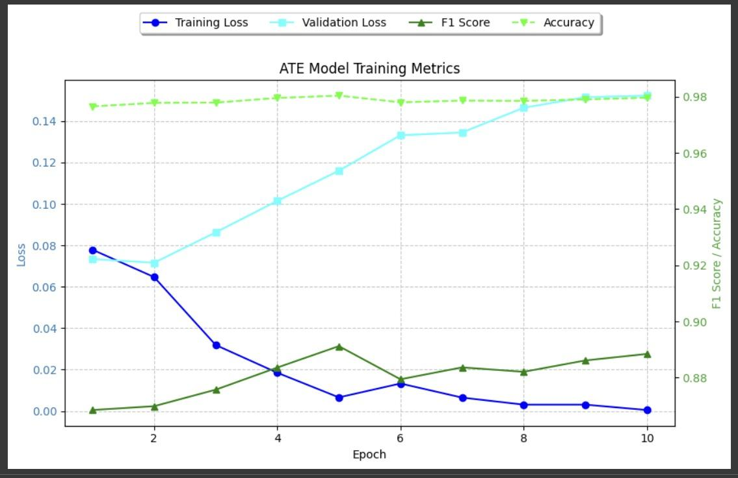

Slide 12
Results - End-to-End ABSA Performance
Task: Extracting the correct aspect term and predicting its correct sentiment.
Metric: Strict F1-Score (requires exact term match + exact sentiment match).
Comparison:
Approach:
Precision Recall F1-Score
Baseline (LSTM) 0.6560 0.6472 0.6516
Pipeline (RoBERTa) 0.7309 0.7506 0.7406
Observation: Pipeline significantly outperforms Baseline (~9 point F1 improvement).

Slide 13
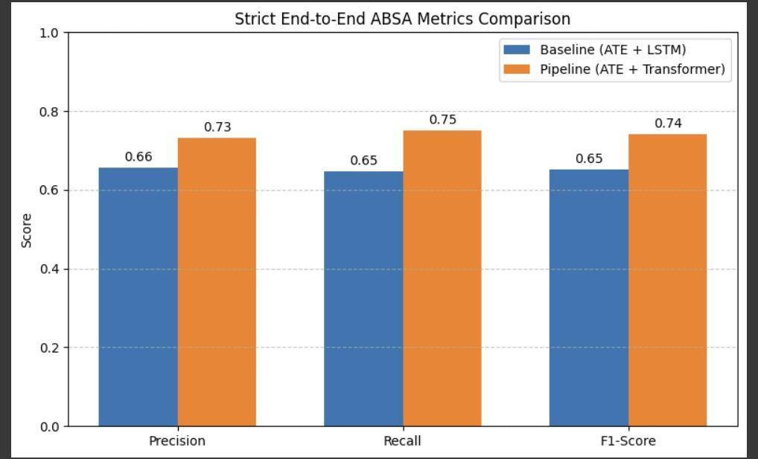

Slide 14
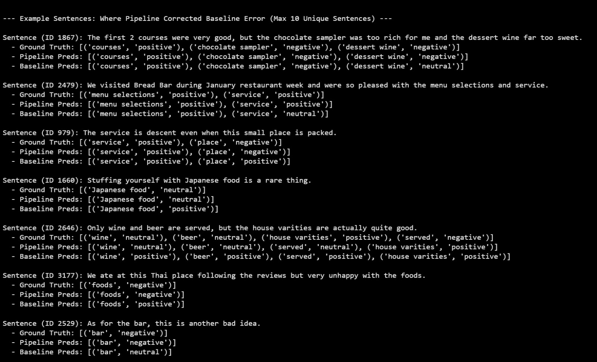
Output

Slide 15
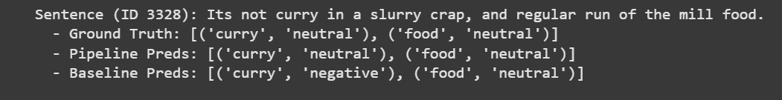
Output
Contd:

Slide 16
Discussion - Performance Analysis
Pipeline Superiority:
RoBERTa-based ASC clearly better than LSTM-based ASC.
Why? Better contextual understanding via self-attention. Effective use of pre-training.
Qualitative Examples:
Pipeline handled negation ("not overlooked" -> positive) and complex context better.
Pipeline better at distinguishing neutral cases where LSTM often assigned polarity.
(Show 1-2 concise examples from the "Pipeline Correct, Baseline Incorrect" output).
Absolute Performance (~0.74 F1 for Pipeline):
Reasonable for this complex task on ~2500 sentences, but indicates room for improvement compared to SOTA on large benchmarks.

Slide 17
Limitations & Future Work
Limitations:
The ATE stage generates errors which affect the complete testing process no matter how high its F1 score reaches ~89%.
The ASC training process demonstrated an increase of validation loss during ASC training stages for both BERT and RoBERTa which suggested sensitivity and indicated a need for better regularization methods involving early stopping mechanisms.
This evaluation method has high standards because minimal errors in the ATE stage cause testing to fail.
The dataset contains uncertain content along with a qualification of equal frequencies between neutral and conflict labels.

Slide 18
Future Work:
Joint Models: Explore models that perform ATE and ASC simultaneously.
Larger/Specialized Models: Try RoBERTa-large or models pre-trained on review data.
Data Augmentation: Combat overfitting and improve generalization.
Hyperparameter Optimization: Fine-tune learning rate, epochs, etc.
Advanced Techniques: Cross-validation, label smoothing.
Detailed Error Analysis: Investigate specific failure modes by class/aspect type.

Slide 19
Conclusion
Summary: Implemented and compared a Transformer (RoBERTa) pipeline against an LSTM baseline for ABSA on restaurant reviews.
Key Finding: The full RoBERTa pipeline significantly outperformed the LSTM baseline (0.74 vs 0.65 end-to-end F1), demonstrating the effectiveness of Transformer models for aspect-specific sentiment classification.
Implication: State of-the art approaches using Transformers are highly beneficial for fine-grained sentiment tasks.
Outlook: While promising, performance can likely be improved further by addressing error propagation and fine-tuning robustness.

Slide 20
Thank You
Questions?

